Slide 1
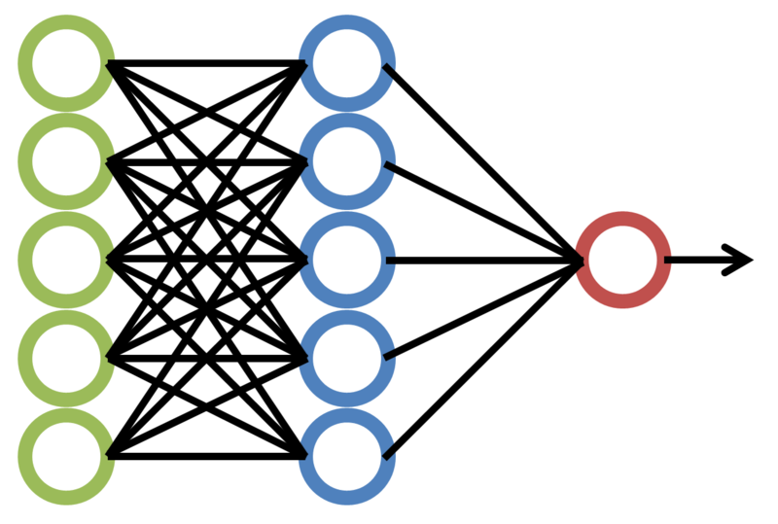
Session 2 – Artificial Neural Networks
1

Slide 2
Agenda
What is an Artificial Neural Network?
Biological neurons.
How does ANN work?
Activation functions.
XOR Gate using ANN – Forward propagation and Back propagation.
Loss.
Loss functions in ANN.
Gradient Descent.
Gradient Descent – how it works.
Stochastic Gradient Descent.
Batch Gradient Descent.
Sample Demo.
2

Slide 3
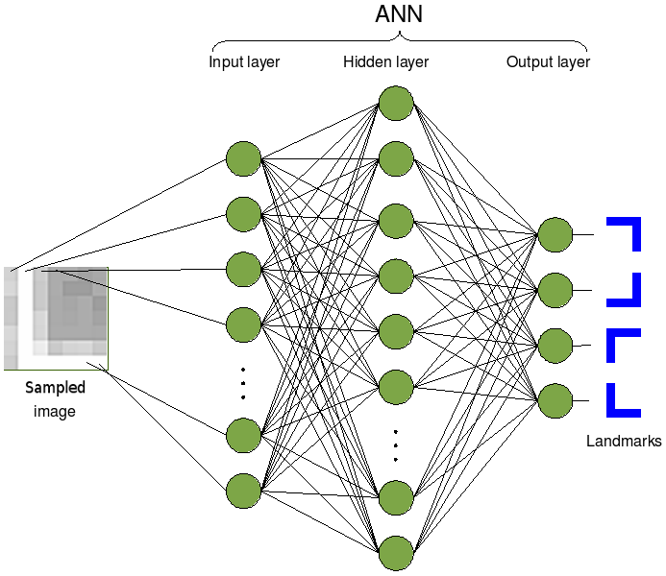
What is an Artificial Neural Network?
A computational model based on the structure and functions of biological neurons.
Learns by observing the datasets and thus helps find patterns in the data being fed.
A basic ANN has three layers – Input layer, Hidden layer and the Output layer.
They learn in batches of data and hence they are slightly economical and quicker too.
There are two types of ANNs – Feed forward and Feed backward.
https://upload.wikimedia.org/wikipedia/commons/2/28/Artificial_neural_network_image_recognition.png
3

Slide 4
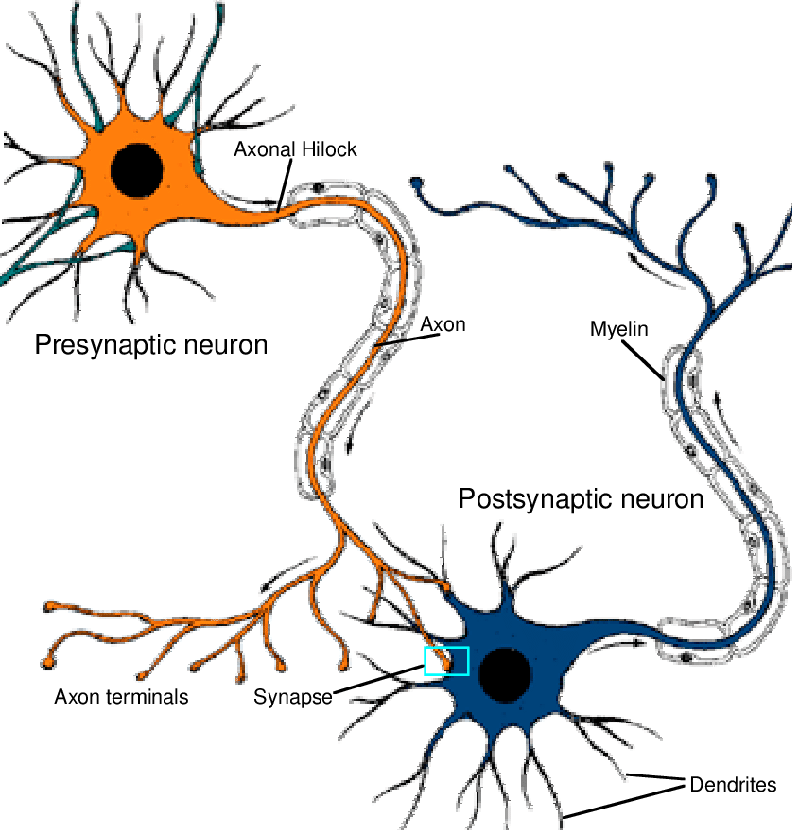
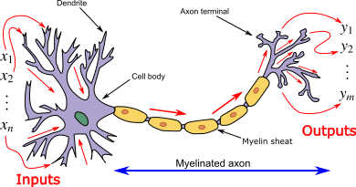
Biological Neurons
Dendrites – Receive inputs
Axon – process the received inputs
Axon terminals – Spit out the outputs and connect the neuron to other neurons.
Synapse and synapse terminals – actual binding between two neurons happen here.
https://commons.wikimedia.org/wiki/File:Neuron3.png
https://www.researchgate.net/figure/How-neurons-are-connected_fig1_246465249
4

Slide 5
How does ANN work?
Foundations for Deep Learning models.
For example, take a function f* where y = f*(x). Here y is the target and x is the input.
The function f* can be written as y = f(theta, x) where theta is the parameter that the deep learning model should find so that the function does not error or minimize errors or give high accurate output. This is called as function approximation.
So, if we have three layers, i.e. a simple ANN, then there are three functions involved in it, one for each layer.
f1 for layer 1, f2 for hidden layer and f3 for output layer.
So, y = f3(f2(f1(x)))
A neuron will fire or activate depending upon the activation function acting upon the weighted sum of inputs and bias.
If “w” is weight and “x” is input then what is weighted sum?
Y = f3( f2 (f1 (x)))
Theta – parameter to be approximated for least error
5

Slide 6
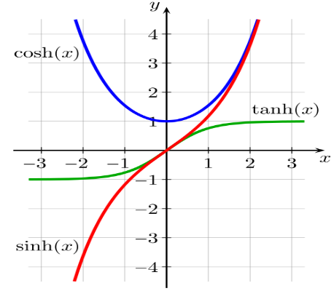
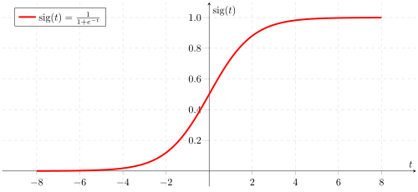
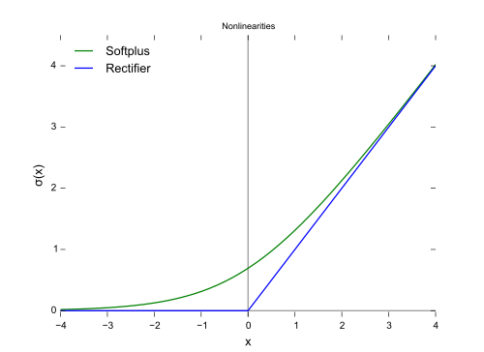
Activation functions
TANH, SINH, COSH
SIGMOID
RELU
Why non-linearity? Hint: weighted sum of inputs
Used to introduce non-linearity in the model.
Determines whether a neuron should be fired (activated) based on the weighted sum of inputs plus bias added to the sum.
https://upload.wikimedia.org/wikipedia/commons/thumb/6/6c/Rectifier_and_softplus_functions.svg/500px-Rectifier_and_softplus_functions.svg.png
https://commons.wikimedia.org/wiki/File:Sinh%2Bcosh%2Btanh.svg
https://upload.wikimedia.org/wikipedia/commons/thumb/5/53/Sigmoid-function-2.svg/500px-Sigmoid-function-2.svg.png
6

Slide 7
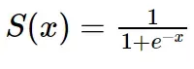
XOR Gate using ANN – Forward Propagation
A S
Sigmoid function formula
1
Input 1 | Input 2 | Output
0 | 0 | 0
1 | 0 | 1
0 | 1 | 1
1 | 1 | 0
B S
D S
1
Weighted sum of hidden layer neurons
C S
A=0.3*1 + 0.4*1=0.7
B=0.7*1+0.6*1=1.3
C=0.2*1+0.5*1=0.7
7

Slide 8
XOR Gate using ANN – Forward Propagation
A S
Sigmoid function formula
1
Input 1 | Input 2 | Output
0 | 0 | 0
1 | 0 | 1
0 | 1 | 1
1 | 1 | 0
B S
D S
1
After activating neurons, A, B and C using the Sigmoid function, the input to output neuron D would be
C S
D = S(0.7) + S(0.13) + S(0.7)=(0.668+0.786+0.668)=2.122
Output of neuron D after applying Sigmoid on input of D is S(2.122) = 0.893
8

Slide 9
XOR Gate using ANN – Forward Propagation
Output of neuron D after applying Sigmoid on input of D is S(2.122) = 0.893
A S
Sigmoid function formula
1
B S
D S
Here the target is 0 and ANN output is 0.89
So error = actual – predicted = 0-0.89 = -0.89
1
Is this a good model? ☺. How to improve the model?
C S
9

Slide 10
XOR Gate using ANN – Back Propagation
Find the difference between actual and target value. Applying sigmoid function on output sum will get the margin of error. Let us call this as result.
Calculate the delta output sum. Going backwards, delta output sum = Sigmoid prime(result).
Delta output sum * Hidden layer results -> will help calculate the change in the weights of the layers.
S(sum)= result and hence S’(sum) = dSum/dResult
Delta sum = (dSum/dResult)*result
Here, result = -0.786, sum = 2.122, So Delta sum = 0.0955 * -0.786 = -0.075
We know that output sum = Weights between H and O * H results (Who*Rh)
From above equation,
then d(outputsum)/d(Who) = Rh. similarly, Who = d(outputsum)/d(Rh)
Going backwards, change in the output sum is the same as the sigmoid prime of the output result.
10

Slide 11
XOR Gate using ANN – Back Propagation
FYI: Result = -0.786, sum = 2.122, So Delta sum = 0.0955 * -0.786 = -0.075
We know that output sum = Weights between H and O * H results (Who*Rh)
From above equation,
then d(outputsum)/d(Who) = Rh. Similarly, Who = d(outputsum)/d(Rh)
From earlier slide we know S(0.7) = 0.668 and S(1.3) = 0.786,
So, hidden result 1 = 0.668, hidden result 2 = 0.786, hidden result 3 = 0.668.
Who = d(outputsum)/d(Rh).
For each neuron,
delta weights = -0.075/[0.668, 0.786, 0.668] = [ -0.112, -0.095, -0.112]
New weights = old weights + delta weights = [0.4+(-0.112), 0.2+(-0.095), 0.3+(-0.112)] = [0.288, 0.105, 0.188]
11

Slide 12
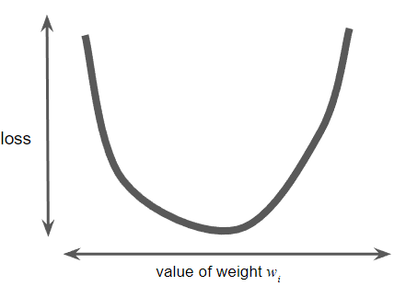
Loss
Training a model means learning good values for the weights and biases and help predict correct values.
If the model predicts wrongly, then a penalty is introduced to the model and this penalty is called Loss.
Loss can be termed as the number which indicates how bad the model is in predicting a single value. If the value is close to zero, then the model predicts better.
The given loss is convex curve and it has just only one minimum where the loss converges. Here, the slope becomes zero.
A simple plot of loss vs weight w1 for all given examples.
Calculating loss for every given “w” value would be very tough. Solution: Gradient Descent
11

Slide 13
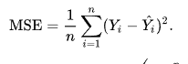
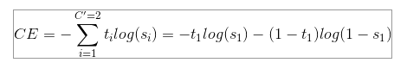
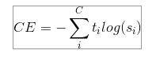

Loss functions in ANN:
Regression Loss:
Mean square error
Mean absolute error
Mean square logarithmic error
Binary Classification Loss:
Binary cross entropy
Hinge loss
Squared hinge loss.
Multi Class Classification Loss:
Categorical cross entropy or multi class cross entropy
Sparse multi class cross entropy
Kullback Leibler Divergence loss.
13

Slide 14
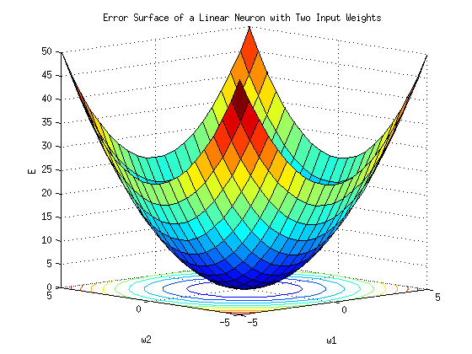
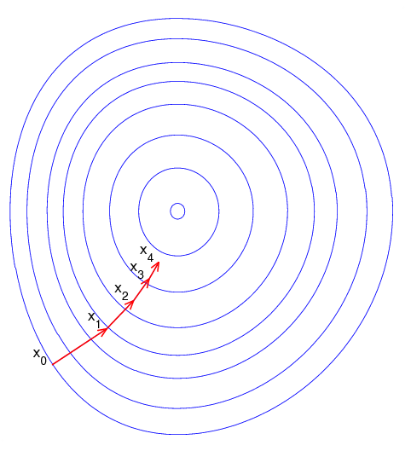
Gradient Descent:
Gradient descent – type of optimizer algorithm
An optimizer comes into picture when a model starts iterating as part of its training phase and helps reduce the loss function and converge it to a minima.
Optimizer is used while compiling the model and minimize the provided cost function. It can be minimized to local minima (often), global minima (rarest).
Each training cycle is called EPOCH and optimizer updates weights and biases so that the cost function will minimize.
https://commons.wikimedia.org/wiki/File:Error_surface_of_a_linear_neuron_with_two_input_weights.png
https://commons.wikimedia.org/wiki/File:Gradient_descent.png
14

Slide 15
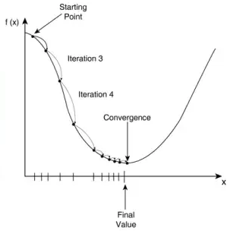
Gradient Descent – How it works:
Pick a starting value to minimize the loss. Mostly it can be any random value.
Calculate the derivative i.e. slope at the starting point. This is the gradient of loss.
When you have multiple parameters and weights, gradient of loss is nothing but the partial derivative of the loss with respect to each weight.
This gradient vector will have both magnitude and direction.
The gradient always points to the direction of the steepest loss increase. Hence we go for the descent of the gradient and so is the name.
The next point is calculated by adding a fraction of the gradient’s magnitude to the starting point. This happens until the loss function converges.
https://www.quora.com/Does-Gradient-Descent-Algo-always-converge-to-the-global-minimum
15

Slide 16
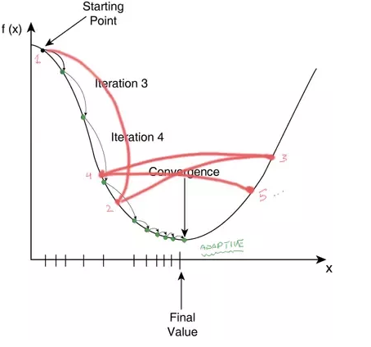
Gradient Descent – How it works:
Learning rate: The learning rate is a parameter that is multiplied to the magnitude of the gradient so that the next point can be ascertained and training can start at that point.
Example: LR=0.1 and starting point=2.5, then the next point would be LR*starting point away from the starting point which is 0.25 here.
Picking a learning rate too small will cause the model to execute indefinitely before converging.
Picking a larger learning rate can cause the model to oscillate and never converge.
Pick an ideal learning rate
https://www.quora.com/In-an-artificial-neural-network-algorithm-what-happens-if-my-learning-rate-is-wrong-too-high-or-too-low
16

Slide 17
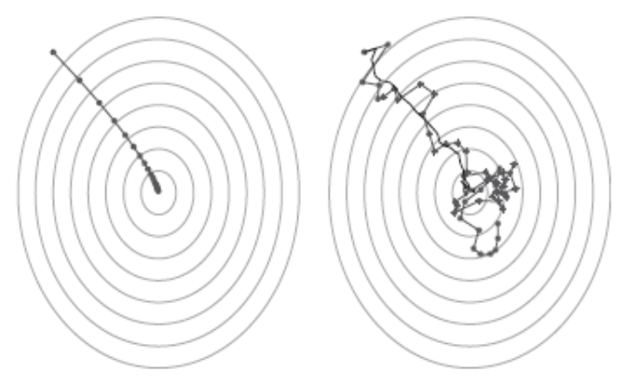
Stochastic Gradient Descent:
Stochastic Gradient descent – helpful when the dataset is very huge with millions of records and thousands of features. But is has its own limitations.
Batch – Total number of examples used in a training iteration.
Stochastic Gradient Descent – An extreme way of training iteration where each iteration will have only 1 example per batch. So, if you have 500 records, there would be 500 iterations. The examples are chosen at RANDOM and hence the name.
Batch Gradient Descent vs Stochastic Gradient Descent
How to resolve issues due to batch gradient descent and stochastic gradient descent? Think…..
https://www.researchgate.net/figure/A-plot-of-the-gradient-descent-algorithm-left-and-the-stochastic-gradient-descent_fig1_303257470
17

Slide 18
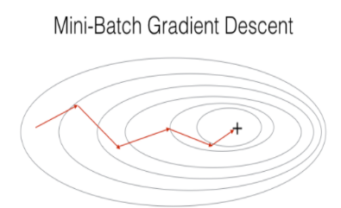
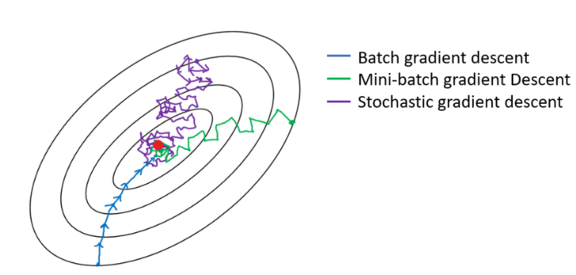
Mini Batch Gradient Descent:
Mini Batch Gradient descent – is a compromise between SGD and BGD.
Typically contains 50-1000 examples chosen at random.
Helps reduce noise in SGD at the same time is effective compared to BGD.
https://www.researchgate.net/figure/A-plot-of-the-gradient-descent-algorithm-left-and-the-stochastic-gradient-descent_fig1_303257470
18

Slide 19
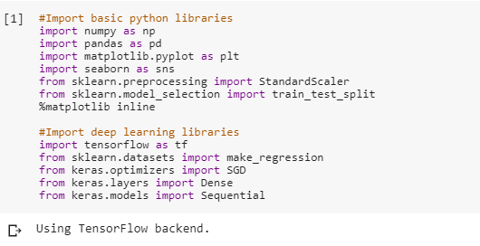
Sample ANN-Demo
Import libraries
19

Slide 20
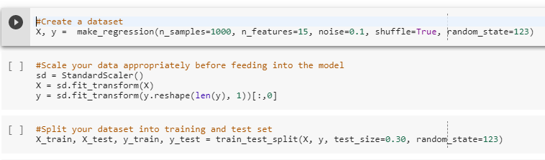
Sample ANN-Demo
Create dataset, scale the dataset and split the dataset
20

Slide 21
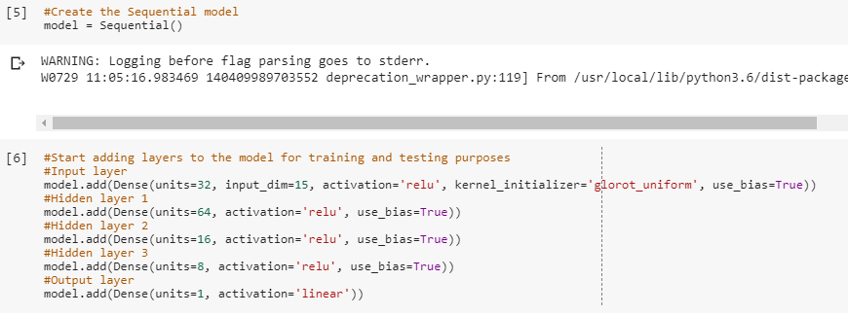
Sample ANN-Demo
Create the model and add layers to the model
21

Slide 22
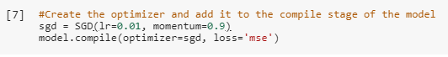
Sample ANN-Demo
Create optimizer and compile the model. Add the optimizer to the compile method of the model.
Fit the data to the model and start training the model
22

Slide 23
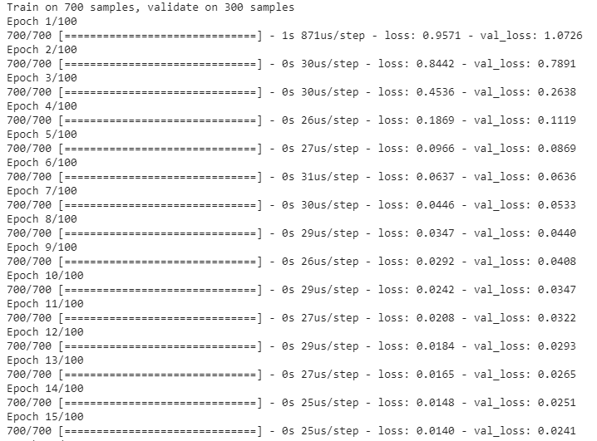
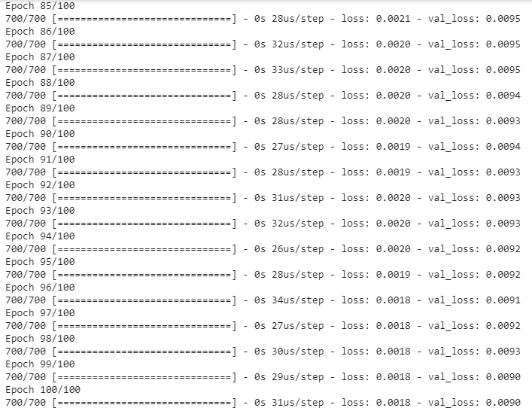
Sample ANN-Demo
Details of random epoch is given below. A total of 100 epochs will be available in the logs.
Epoch info from first 15 logs
Epoch info from last 15 logs
23

Slide 24
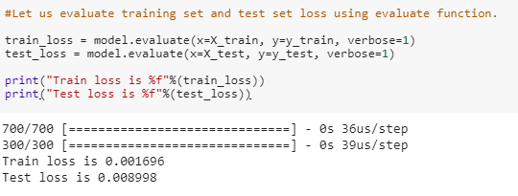
Sample ANN-Demo
Evaluate the model and calculate the loss
24

Slide 25
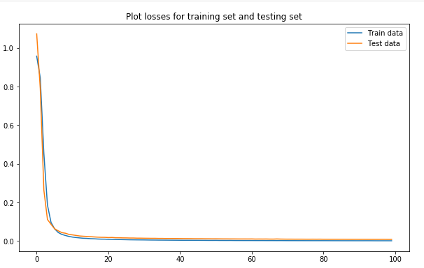
Sample ANN-Demo
Plot the training and test loss
25

Slide 26
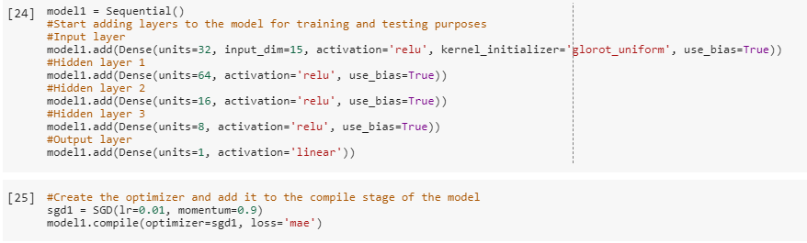
Sample ANN-Demo
Let us try the same model with error = Mean absolute error
26

Slide 27
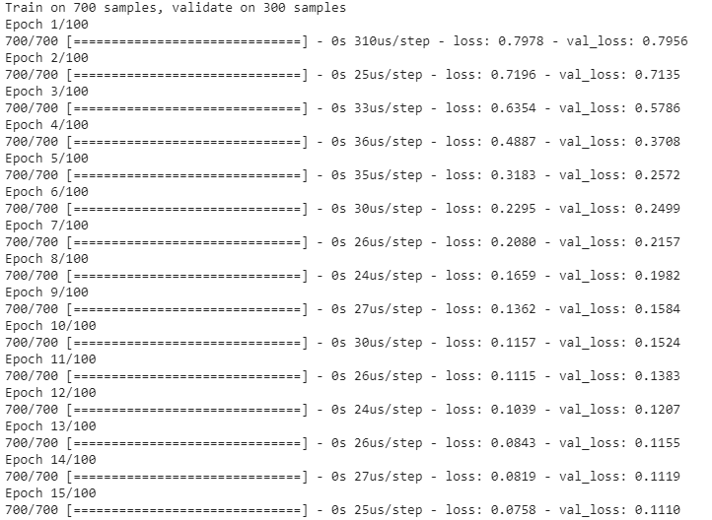
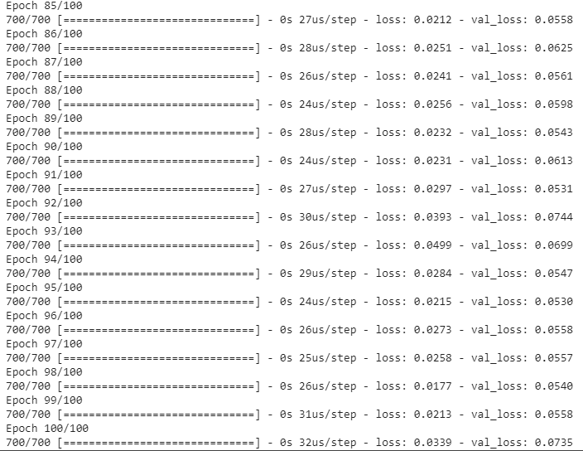
Sample ANN-Demo
Let us try the same model with error = Mean absolute error
27

Slide 28
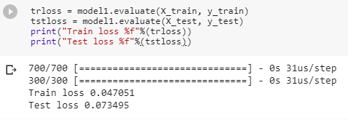
Sample ANN-Demo
Let us try the same model with error = Mean absolute error
28

Slide 29
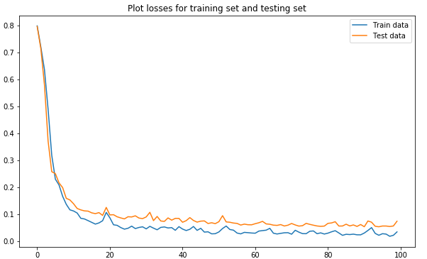
Sample ANN-Demo
Let us try the same model with error = Mean absolute error
29

Slide 30
Thanks!
Try it yourself:
Create a simple ANN model and try calculating error metric using mean square logarithmic error. What difference do you see in the metrics?
See how to create a simple ANN model for classification. What are the metrics you can find while executing a classification algorithm?
Try using various units of neurons, add more layers, change the optimizer and check how output differs in each case for training set and testing set.
Thanks!
30

